Slide 1

CS442 Term Project MobilePT:~~~~
CS442 Term Project
KaiPT: KAIST Personal Trainer
Team 1 Half Presentation
Gym-Carry / In Yong Koo
Team 1 Elevator Pitch
InYong Koo, ChangHeon Kim

Slide 2
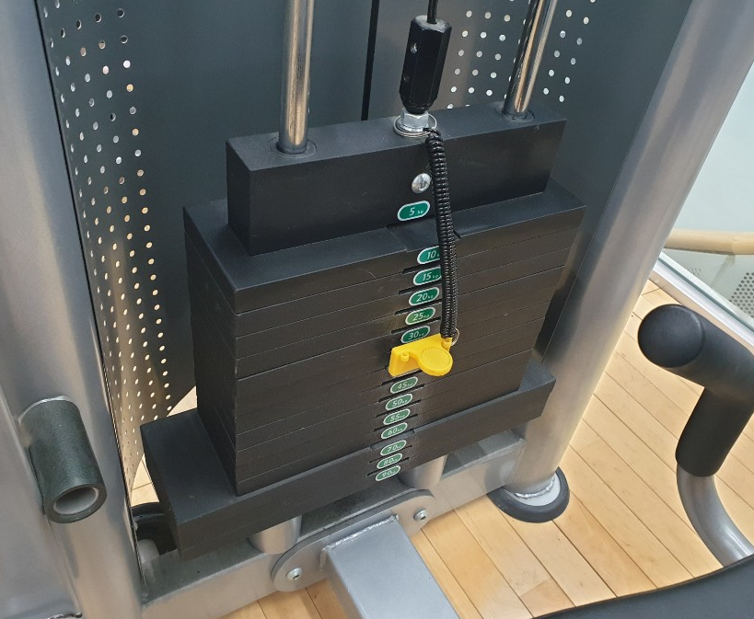

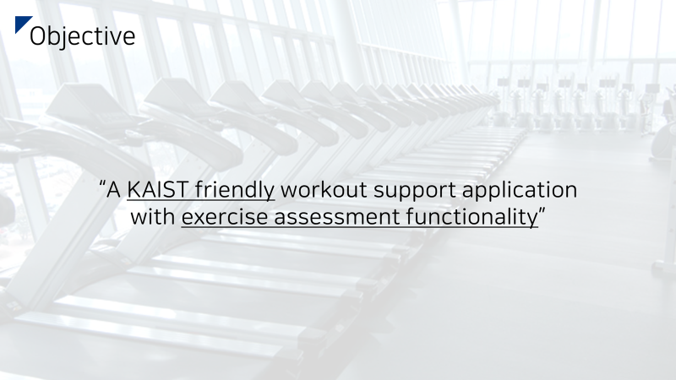
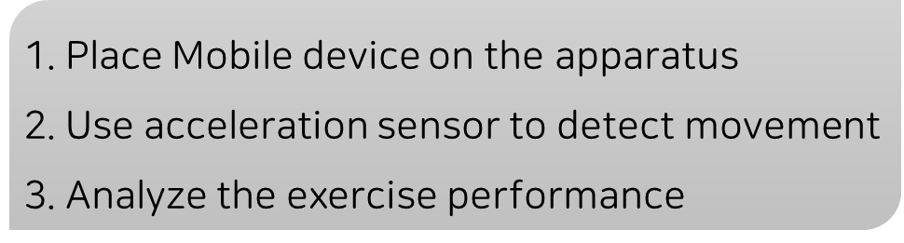
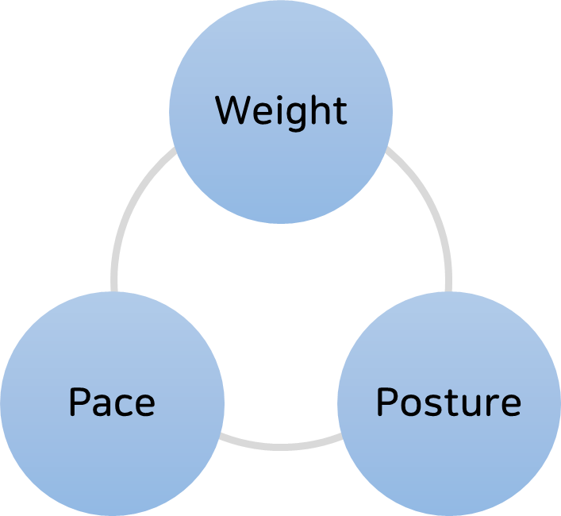
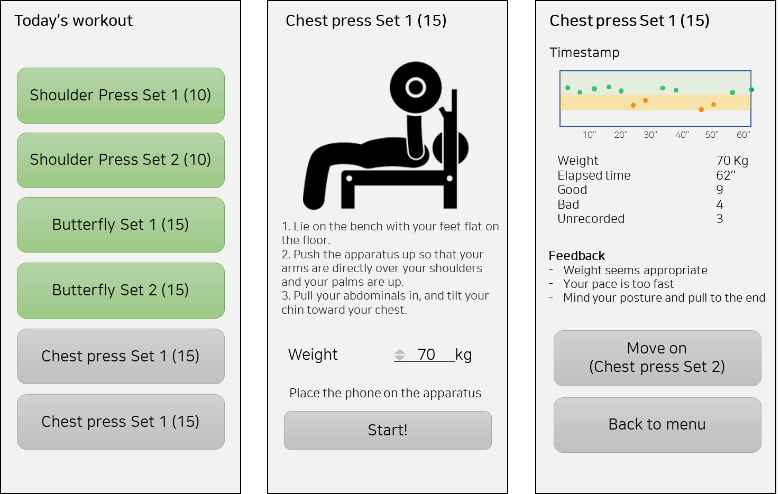
Reminder
Notes:
Keywords
Classifier, Perceptron
Loss function, Backpropagation, Hyperparameter
Adam optimizer,

Slide 3
Reminder
Feedbacks
Won’t the mobile device fall?
How are you going to stick the smartphone?
Will it be accurate?
How?
How can we assess posture?
Notes:
Keywords
Classifier, Perceptron
Loss function, Backpropagation, Hyperparameter
Adam optimizer,

Slide 4
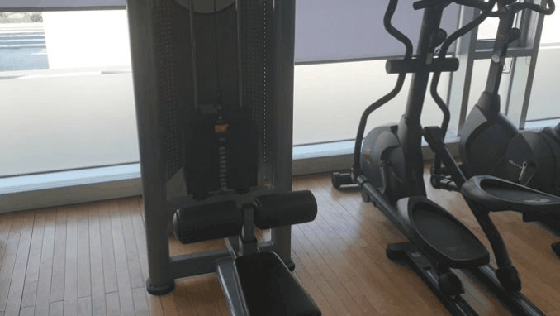
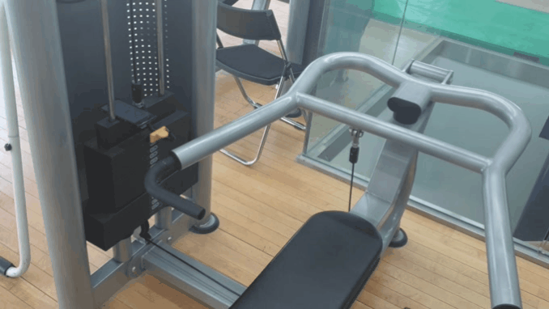
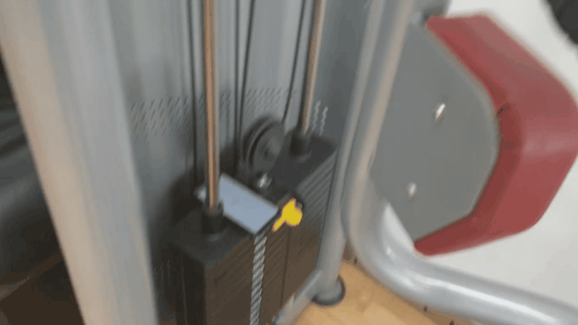
Attaching Device
won’t be a serious issue.
It stays completely stable without any additional apparatus.
We can increase friction using rubber cover if necessary.
Notes:
Keywords
Classifier, Perceptron
Loss function, Backpropagation, Hyperparameter
Adam optimizer,

Slide 5
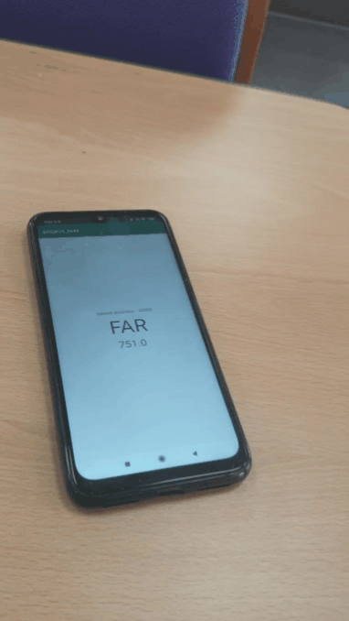
Sensoring
Aim: Real-time device (weight) elevation detection
- Linear acceleration sensor
“Derive relative position via dead reckoning(?)”
$$Accelration_{z} →Speed_{z}→Position_{z}$$
I tested. It failed.
Double integration of error + too small range of motion
+ Light sensor
“Different height, different lighting environment”
+ Proximity sensor
Notes:
Keywords
Classifier, Perceptron
Loss function, Backpropagation, Hyperparameter
Adam optimizer,

Slide 6
Workout Evaluation
Ideal timestamp
Minimum RoM
Regular and sufficient RoM
Desirable pace
* RoM and pace can be calibrated
Elevation
Time
Bad case #1.
Bad case #2.
Too fast pace
Maybe too light
Too slow pace
Maybe too heavy
Notes:
Keywords
Classifier, Perceptron
Loss function, Backpropagation, Hyperparameter
Adam optimizer,

Slide 7
Workout Evaluation
Ideal timestamp
Minimum RoM
Regular and sufficient RoM
Desirable pace
* RoM and pace can be calibrated
Elevation
Time
Bad case #3.
Bad case #4.
- Incorrect posture
- Incorrect posture
Notes:
Keywords
Classifier, Perceptron
Loss function, Backpropagation, Hyperparameter
Adam optimizer,

Slide 8
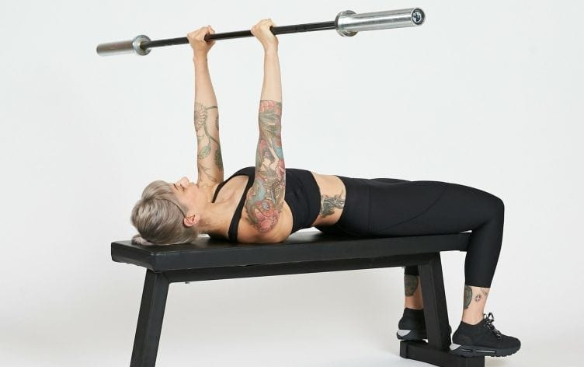
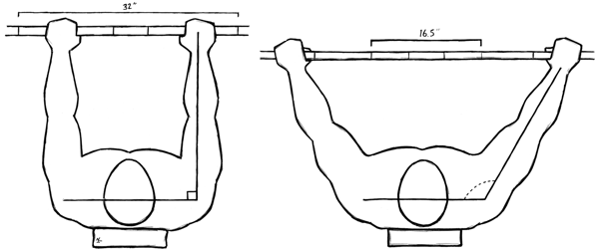

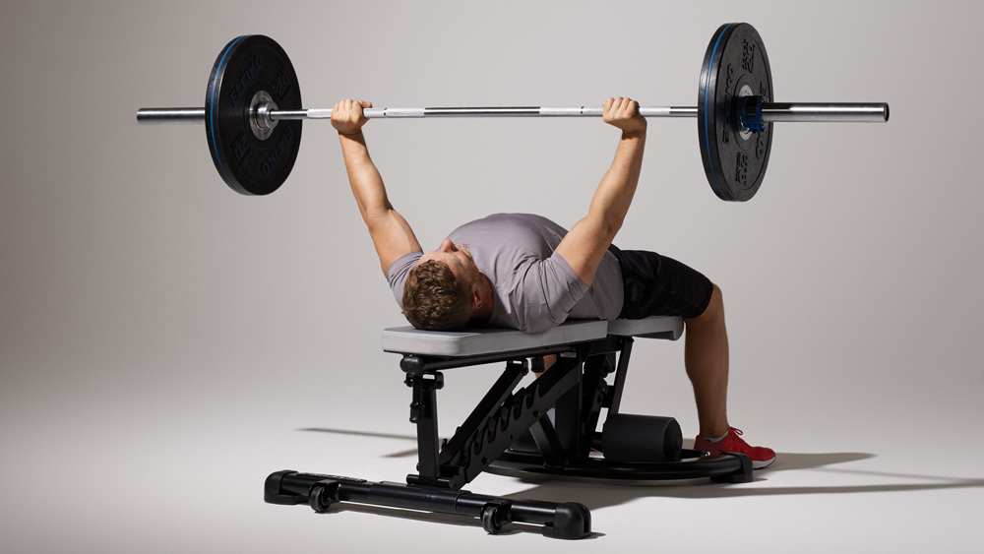
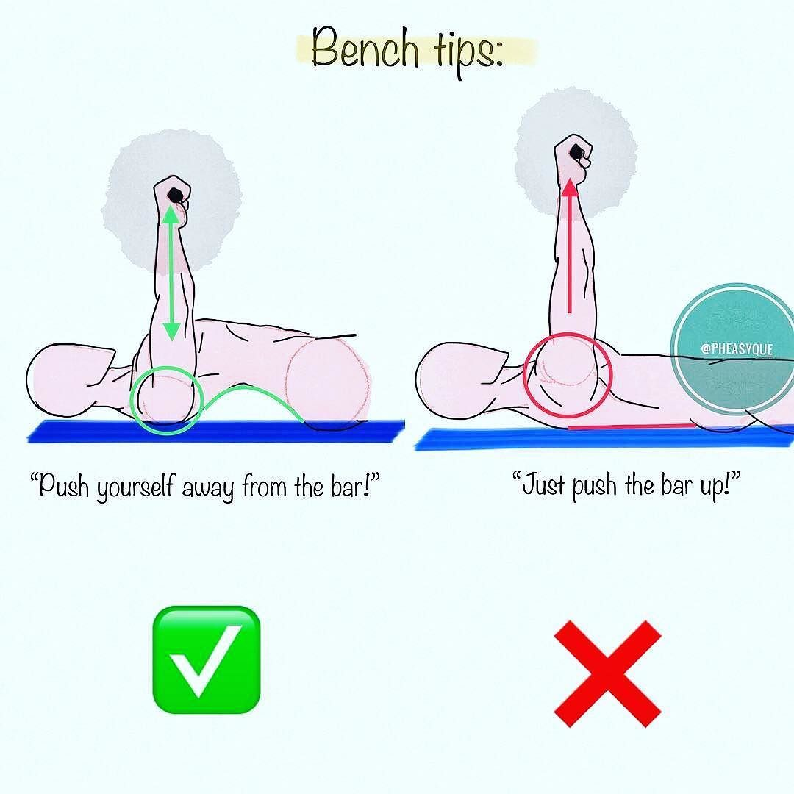
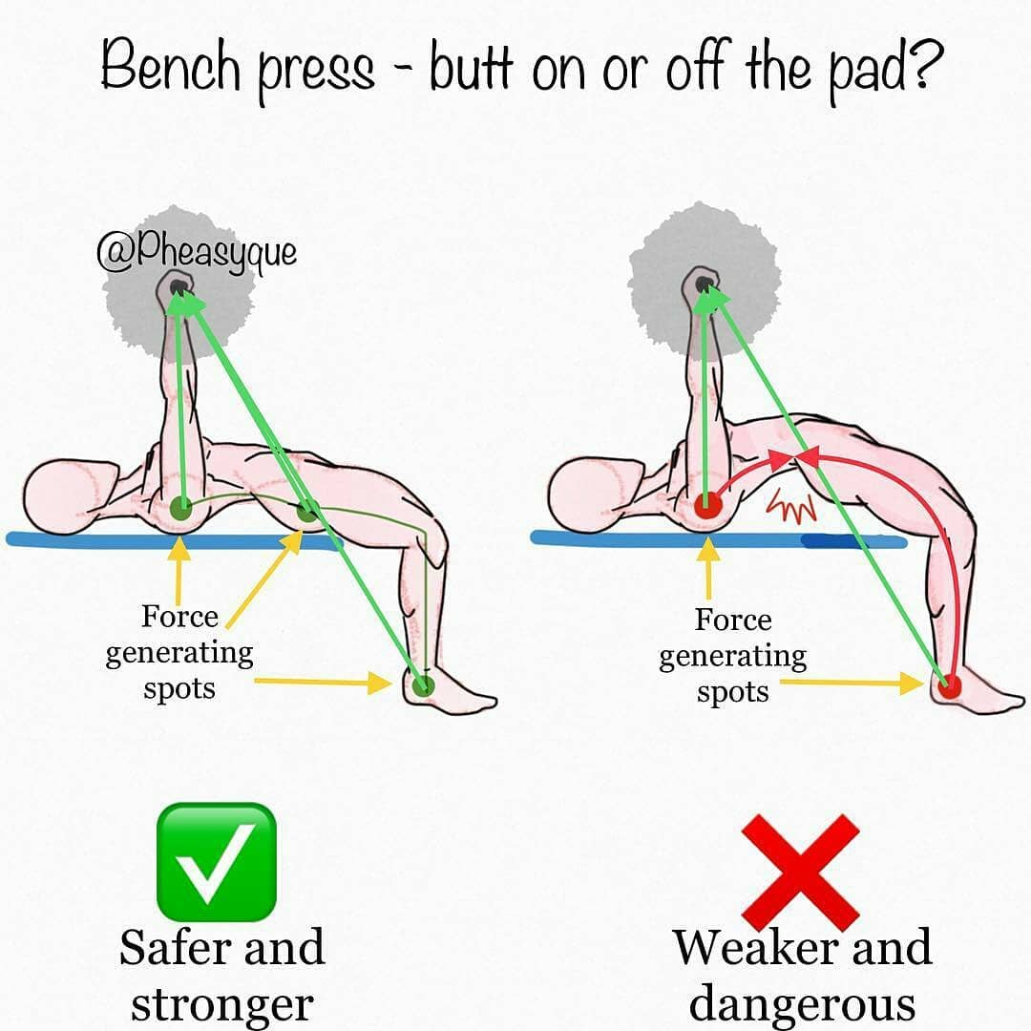
Posture Evaluation
Grip
Close grip Wide grip
Stimulated Region
Tricep
Chest
Shoulder
Range of Motion
Large
Small
Original Plan:
Use Muscle sensors and force sensors to evaluate posture with precision
Notes:
Keywords
Classifier, Perceptron
Loss function, Backpropagation, Hyperparameter
Adam optimizer,

Slide 9
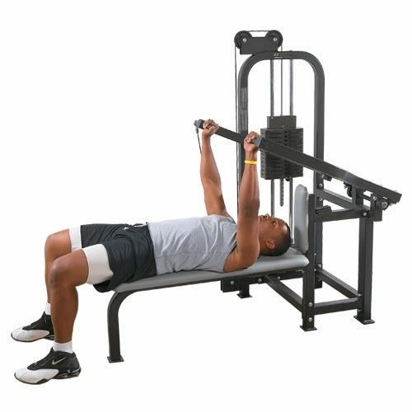
Posture Evaluation
“Let’s keep it simple”
No extra device.
-Smith machine (chest press) is designed for safety.
-Provide detailed tip for better posture
Notes:
Keywords
Classifier, Perceptron
Loss function, Backpropagation, Hyperparameter
Adam optimizer,

Slide 10
Scope change
I will focus on chest press
Different exercise: different RoM, pace.
Routine recommendation needs more expertise
Notes:
Keywords
Classifier, Perceptron
Loss function, Backpropagation, Hyperparameter
Adam optimizer,

Slide 11
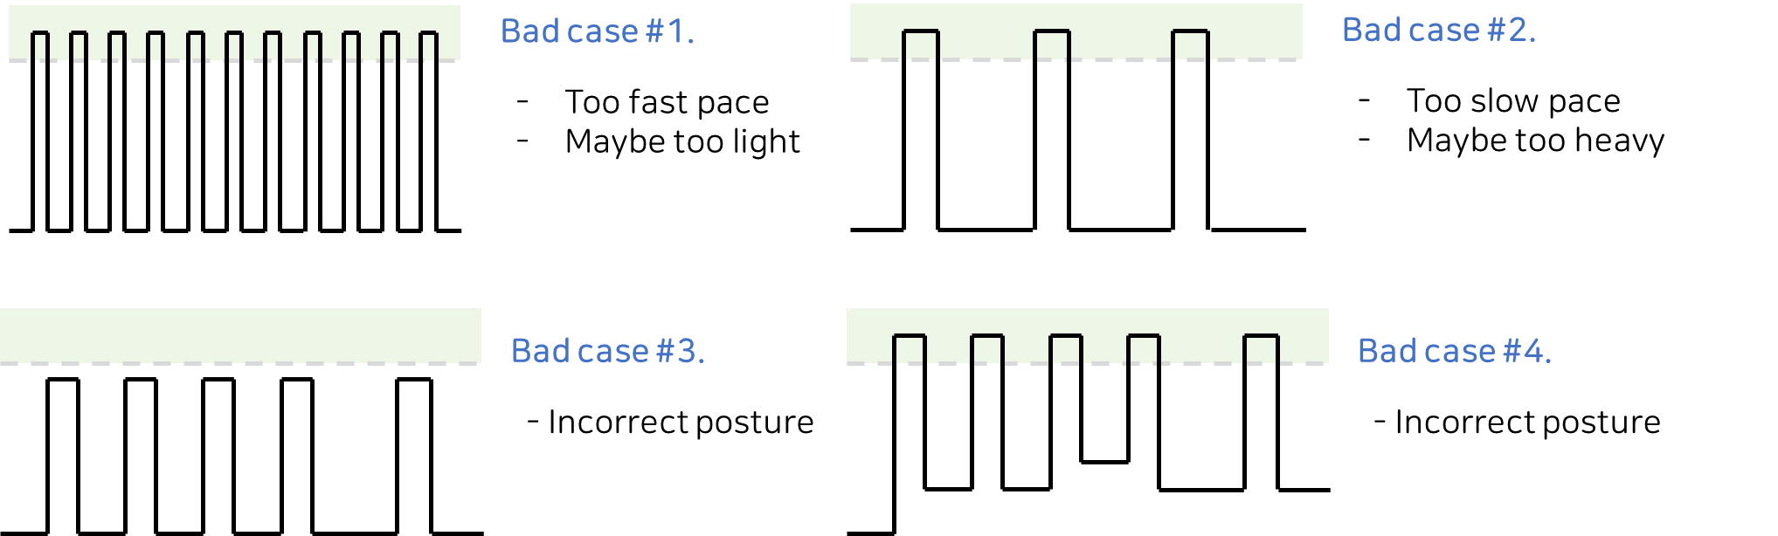
Project Evaluation plan
Hypothesis validation - Check if my application diagnose the problem correctly and give appropriate advice.
Notes:
Keywords
Classifier, Perceptron
Loss function, Backpropagation, Hyperparameter
Adam optimizer,

Slide 12

Project Evaluation plan
Hypothesis validation - Check if my application diagnose the problem correctly and give appropriate advice.
Notes:
Keywords
Classifier, Perceptron
Loss function, Backpropagation, Hyperparameter
Adam optimizer,

